Slide 1


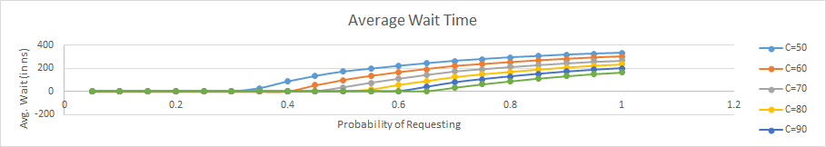
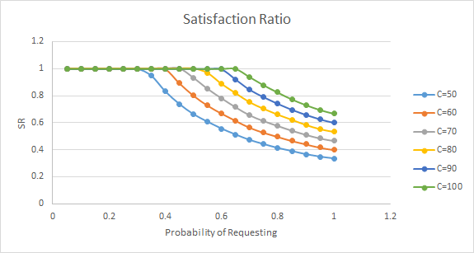
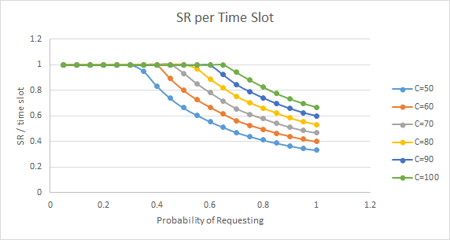
Controlled Delivery Power Grid - Simulating the Server
Haard Shah, Matthew Petrula
Networking Research Laboratory
Advisor: Prof. Roberto Rojas-Cessa
Department of Electrical and Computer Engineering, NJIT
Abstract
Discussion of Results
While the power grid has become more integrated and complex, its underlying concept has not changed much in the last 150yrs. The problems of the current system may be traced to two issues: Energy is consumed in discretionary amounts and time and power lines are permanently energized. While these properties have been proven robust, they are not optimal for power delivery and energy generation, and make the power grid prone to blackouts. Therefore, we propose a different and radical approach, called digital power grid, where the power delivery is controlled as distributed energy packets. Such an approach requires a fusion of networks and power systems, which transmit data and power respectively. The digital grid operates in a proactive mode based on loads sending requests for energy before the energy provider grants those requests, if there is enough energy for them. While this approach furnishes new advantages in the management of energy delivery, it also generates some questions. Therefore, we study response time and scalability in this simulation.
Simulation Overview
Because loads can request up to 20 time slots of energy in each request, we expect to achieve 100% satisfaction of requests. However, the results with smaller capacities show that customers already achieve this level of satisfaction despite providing smaller capacities that the maximum expected.
We simulated a server of different capacities providing power to 100 clients. Clients could request discrete energy amounts between 0 and 20 units, based on some probability parameter which we swept from 0 to 1 in 5% increments. The server was set to grant 1 unit of energy per request as it arises in each time slot.
Benchmarks
Proportion of granted requests for all time and for short periods
Satisfaction ratio (SR) = total served requests / total generated requests
SR per time slot = total time slots satisfied / generated time slots
Calculated the average waiting time for each client
Conclusions
The Controlled Delivery Power grid aims to control the delivery of energy proactively. Here, we tested a new approach for requesting energy through a parallel data network. Our results showed that energy requests are mostly satisfied without having to allocate maximum energy capacity.
Results for Server Capacities: {50, 60, 70, 80, 90, 100}
Areas of Improvement
Research Objective
This project aims to test a new efficient policy for the request of energy so as to reduce the number of issued requests. By simulation, we aim to find the effect on the amount of energy granted to requesting loads.

